Slide 1



Peak ETL
Open-source Technology Success
Jason Holden
www.peaketl.com
CEO, PRESENTOR
JASON@PEAKETL.COM | (918) 409-CODE (2633) | (719) 310-5240
Notes:
PREP:
Make sure VM is started and cleared (cloud.google.com)
Login to VM and run ~/apps/open-source-success-presentation/webapp/clear-docker.sh
Start WSL ssh key agent: eval `ssh-agent -s`
Add SSH key to agent: ssh-add
Test ./webapp/publish.sh
Test connection to http://5.tcp.ngrok.io:24138/ (Should work)
Run ~/apps/open-source-success-presentation/webapp/clear-docker.sh on the VM again
Test connection to http://5.tcp.ngrok.io:24138/ ( Should not work)
Pull up local WSL project in Explorer
Make sure ./ping/app and ./gpu/app is removed

Slide 2

About
Me
The Story (so far):
I started working with computers at the age of 13. Growing up in a small town in eastern Oklahoma, I acquired a reputation as the “computer kid.” Shortly after graduating high school, I got my first software development job working with Visual FoxPro. Since then, I’ve used numerous other languages and platforms to develop countless database applications and services. My newest endeavor is Peak ETL. At Peak ETL, we’re creating a subscription-based platform to aggregate and analyze public oil and gas data and deliver it to industry professionals for use in their operations.
Jason Holden
CEO & Founder

Slide 3

Open-source
Development
Why Open Source?
Cost
Cost: Products like MySQL and PostgreSQL reduce licensing costs compared to commercial solutions like Microsoft SQL Server and Oracle.
Flexibility: Provides unparalleled flexibility, allowing developers to modify source code, integrate diverse technologies, and deploy applications across various platforms without vendor lock-in
Community: Active and talented communities contribute to rapid development, troubleshooting, and feature enhancements
Transparency: Community members can review and audit the source for security vulnerabilities
Everywhere: Open source is everywhere, from tech giants (including Microsoft) to little startups (like Peak ETL)
Reduce licensing costs compared to commercial solutions.
Advancement
Open-source projects advance faster.
Customizable
Modify for specific business needs.
Notes:
The correct usage is "open source" (without a hyphen) when referring to the concept in general and "open-source" (with a hyphen) when used as an adjective before a noun, like "open-source software.“

Slide 4
Open Source vs. Commercial
Comparison
Pros
Lower licensing cost (usually no licensing costs)
Highly customizable
Community-driven for fast-paced advancement
Open access to source code for auditing
Easily scalable and modular components
Cons
Higher cost for talent driven by a smaller pool
Lack of formal support channels
Multiple vendors can add complexity and challenge integration efforts
Sources: servermania.com and redresscompliance.com
Small: < 100 Users / 1 – 2 TB | Medium: 100 – 1000 Users / 5 – 10 TB | Large: 1000+ Users / 10+ TB
Notes:
SQL Licensing: https://www.servermania.com/kb/articles/sql-server-cost
Oracle Licensing: https://redresscompliance.com/oracle-technology-price-list-how-to-calculate-pricing/

Slide 5










Our
Stack
The Best of All Worlds
Code: C#, Java, Python, and JavaScript
Database: Postgres, Microsoft SQL, and MongoDB
Source control: Github.com
OS: Linux and Windows

Slide 6
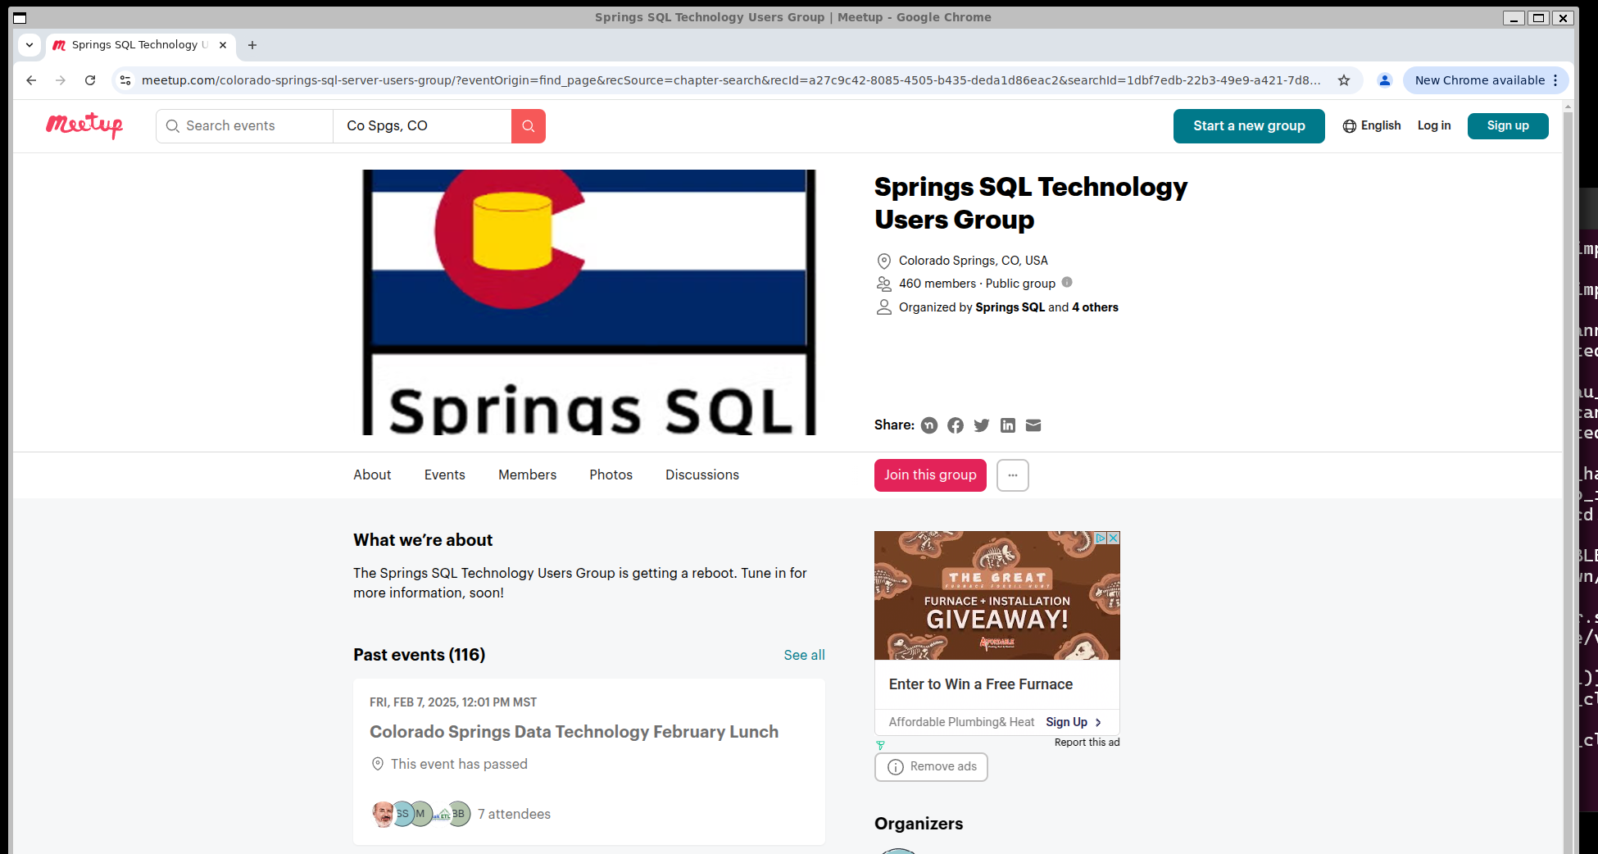
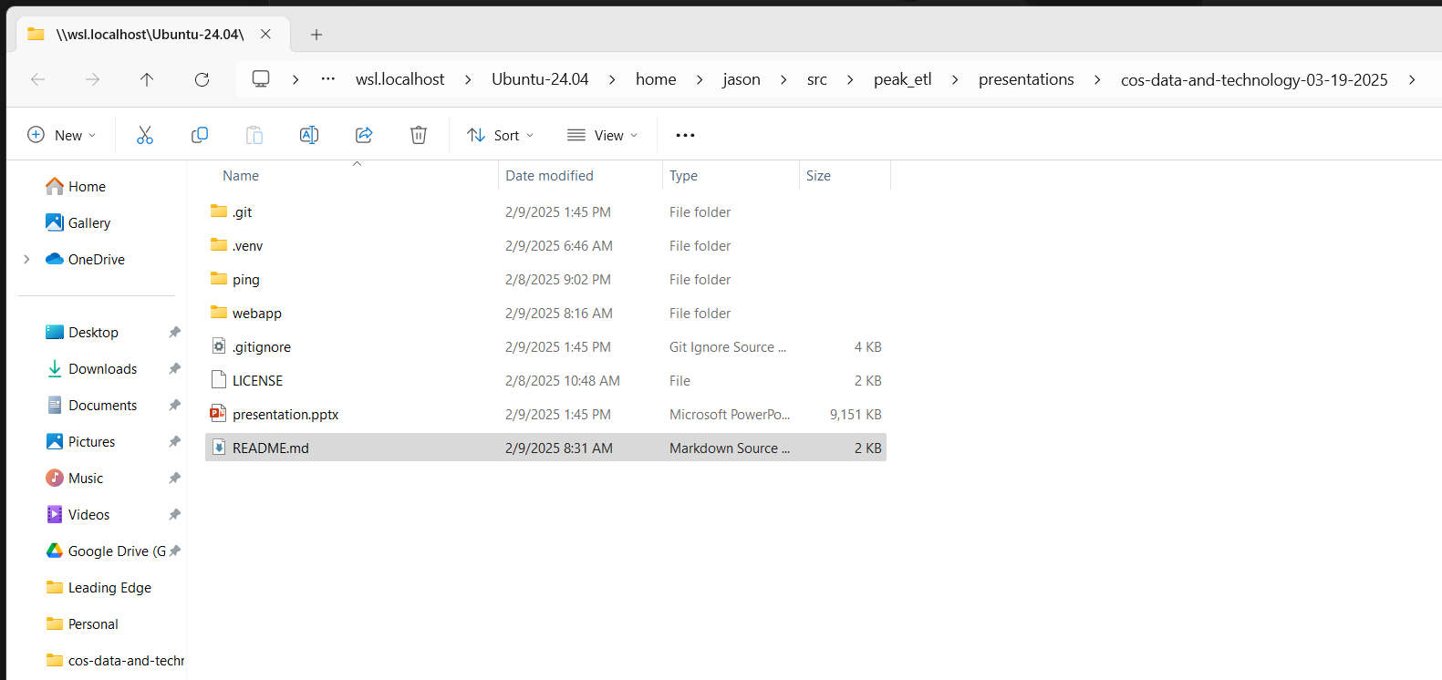
Demo
WSL
Windows Subsystem for Linux
Integration: Seamless integration between Windows and Linux
Fast: Fast startup with low resource usage
GPUs: Use the latest AI toolsets directly from Windows with full hardware acceleration (WSL 2)
Support: Supports lots of popular Linux distributions
Multi-Instance: Install more than one distribution
Linux Apps: Run Linux GUI applications through Windows
NOT FOR PRODUCTION USE
System Requirements
Recommend using WSL 2 for a genuine Linux kernel and GPU support
Windows 10 (build 1909) or Windows 11
DO NOT USE the Windows App Store
Notes:
Open Ubuntu WSL
CMD: cat /etc/os-release
CMD: chromium
https://www.meetup.com/csopensource/
https://www.meetup.com/colorado-springs-sql-server-users-group/
Demo drag and drop from Windows
Demo Docker Desktop (Windows)

Slide 7
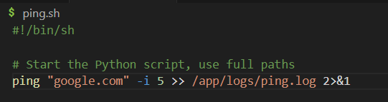
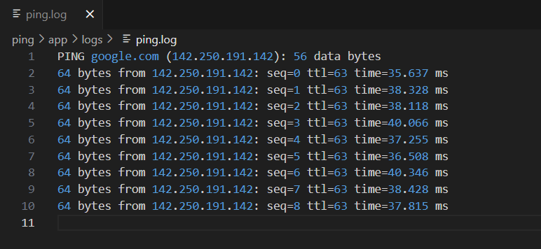
Demo
PING
PING a remote server
Code: ping.sh to execute PING and log to a file
Container: Dockerfile maps /app folder on the host for easy access to log files
Notes:
Show ./ping/start.sh
Show ./ping/docker-compose.yml
Show ./ping/Dockerfile
Run ./ping/start.sh
Log demo in ./ping/app/logs
Python Virtual environments, dependency management like npm or go mod

Slide 8
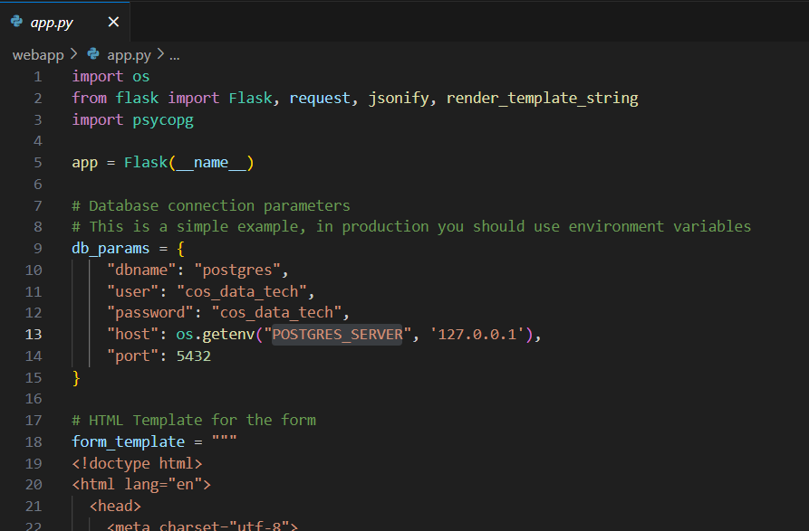
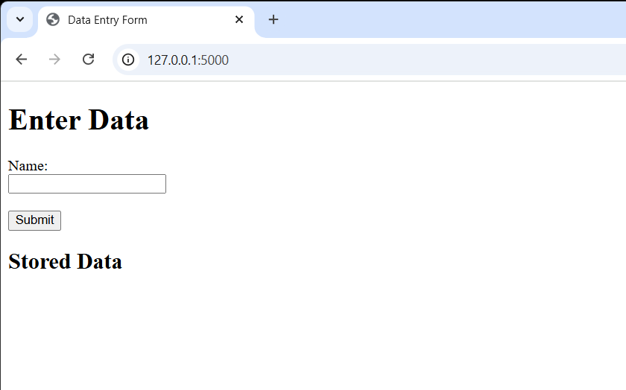
Demo
Web Application
Flask Web Application
Code: app.py Flask application with single data entry form
Containers: App_Dockerfile (Python) and DB_Dockerfile (Postgres)
Notes:
Demo:
./webapp/start-db.sh
python app.py
Demo HeidiSQL
Kill application and demo non-persistent storage

Slide 9
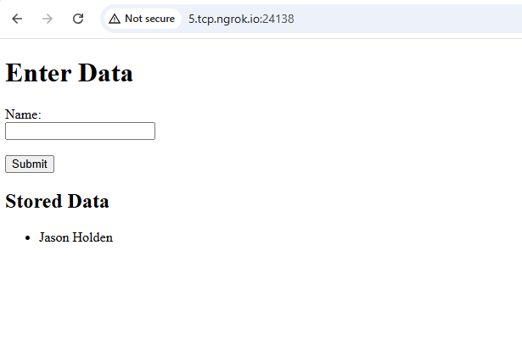
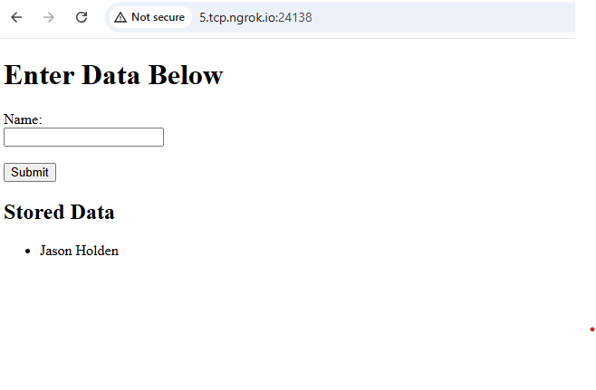
Demo
Publishing
Publishing Containers
Build.sh
Build App and DB docker images into portable tar files
Publish.sh
Call ./Build.sh
Use scp to copy the necessary files to the remote server
Use ssh to automate Docker on remote server and publish images
Notes:
Show ./webapp/docker/App_Dockerfile
Show ./webapp/docker/DB_Dockerfile
Show ./webapp/publish.sh (Root one)
Show ./webapp/publish/App_Dockerfile
Show ./webapp/publish/DB_Dockerfile
http://5.tcp.ngrok.io:24138/
http://open-source-success-presentation.peaketl.com:24138

Slide 10
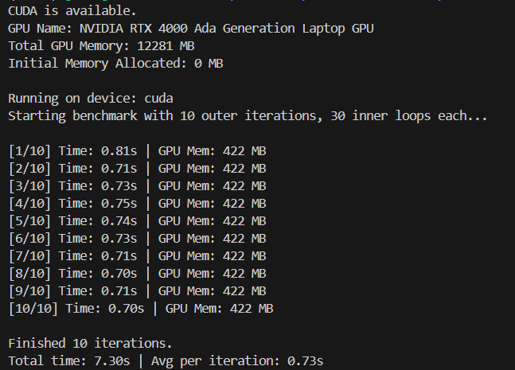
Demo
GPU
Publishing Containers
app.py
PyTorch demo showing tensor benchmarks
app.sh
Runs app.py
Logs results /app/logs/gpu.log
loop.sh
Executes ./app.sh in a loop
docker-compose.yml
Special directives to enable GPU
Notes
Requires WSL2
GPU driver needs to be greater than or equal to the version installed in the Docker image
Notes:
Show ./gpu/app.py
Show ./gpu/app.sh
Show ./gpu/entrypoint.sh
Show ./gpu/loop.sh
Show ./gpu/Dockerfile
Show ./gpu/docker-compose.yml

Slide 11
Key
Take Aways
Open Source is the Future
Development:
Open source can jump-start your development
Allows developers to define their infrastructure, significantly speeding up development
Not mutually exclusive:
Run Linux application on Windows
Run Windows applications, including SQL Server, on Linux
Future proof:
Leading AI toolsets are built on open-source technology
Microsoft uses Linux extensively in their Azure cloud platform

Slide 12

Contact
Us
GitHub
https://github.com/peaketl/open-source-success-presentation
CONTACT
(719) 310-5240 (918) 409-CODE (2633)
www.peaketl.com
jason@peaketl.com

